Slide 1
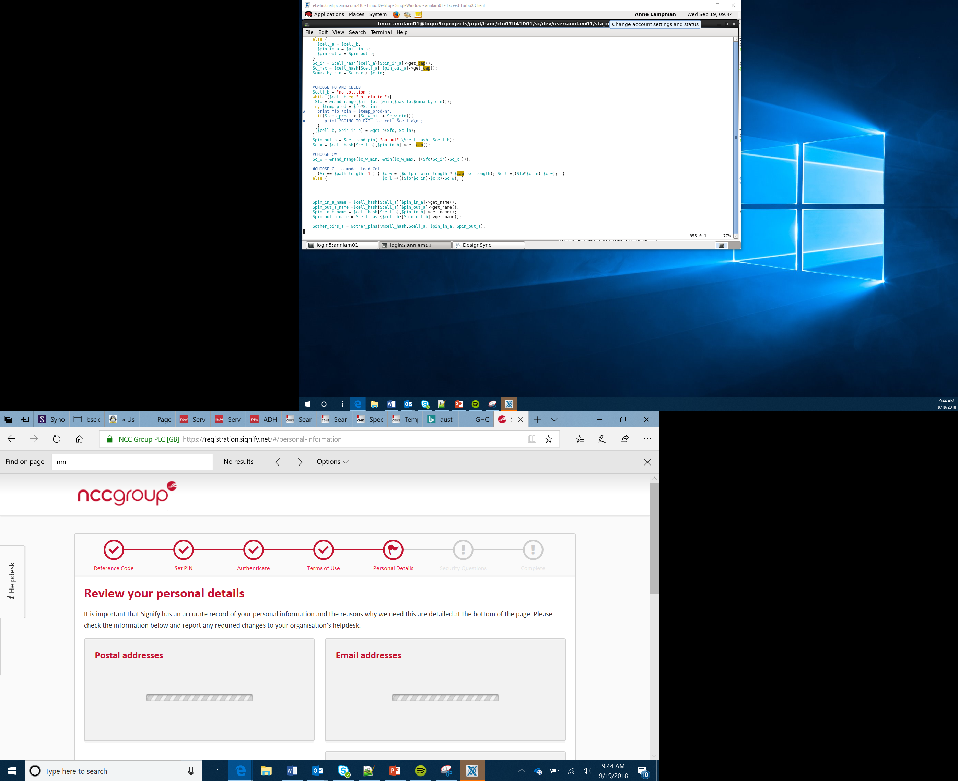

Gestures and Movement
Lesson 10

Slide 2
What the Lesson Will Cover
Understand what a gesture and a movement are
Know how to read a gesture on the micro:bit
Apply gestures and responses in a program
Apply the use of selection
Apply the use of lists

Slide 3
Gestures and Movements
What are the differences between a gesture and a movement?
Can you make any movements?
Can you make gestures?
How about ones that you use on your mobile phone?
The micro:bit can use acceleration to sense various gestures or movements, such as up, down, left, right, face up, face down, freefall, 3g, 6g, 8g and shakes
These are based on the acceleration meeting a particular pattern
Consider this example: moving your thumb means nothing, but holding your thumb up straight is a ‘thumbs up’ sign
Notes:
Discuss the difference between gestures and movements,
Get Learners to demonstrate common gestures and movements, OK sign, a wave etc.

Slide 4
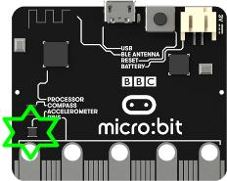
Gestures
To determine the gesture the data from the accelerometer has to be interrupted
Imagine the electrode hitting the left hand side, this could be a left tilt
If the electrode hitting the right hand side, this could be a right tilt
Finally the electrode repeatedly hitting the left side and then the right, could be shaking the micro:bit

Slide 5
Gestures and Movements
What about throwing the micro:bit
Or dropping it
Different accelerations mean different events
We can program the micro:bit to respond to these different events
Notes:
Perhaps throw the micro:bit to another students to catch it and then drop it to show the differences.

Slide 6
Try out Some Gestures
from microbit import *
while True:
gesture = accelerometer.current_gesture()
if gesture == "face up":
display.show(Image.HAPPY)
else:
display.show(Image.ANGRY)
Notes:
Discuss the program and what it does, note that we can ask the micro:bit what the current gesture is and store this in a variable.
Then we can use selection to test if the micro:bit is ‘facing up’ if it is then show a happy face, else a sad face.
Learners can copy up this code as part of activity one.

Slide 7
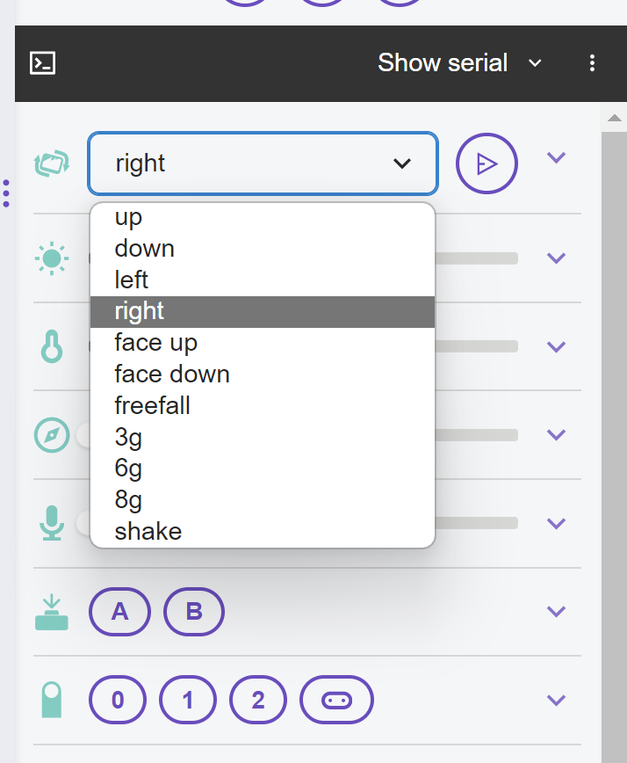
Adapt Your Program to Test out Some of These
Freefall
3g
6g
8g
Shake
MicroPython is able to recognise the following gestures:
Up
Down
Left
Right
Face up
Face down
To test the gesture on the emulator, select the appropriate gesture from the drop down box.
Notes:
Display on board and encourage Learners to adapt their programs to test one or more of these gestures.

Slide 8
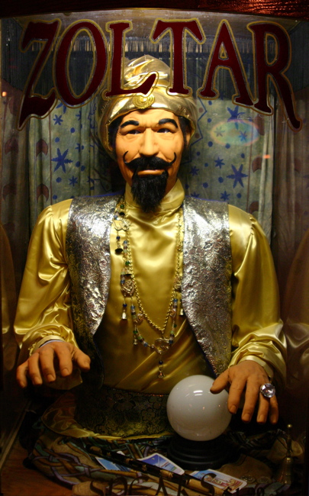
Fortune Telling Machine
You are now going to make a fortune telling machine.
Ask your micro:bit, the fortune telling machine, a question and then shake it.
This Photo by Unknown Author is licensed under CC BY-NC-ND
Notes:
Introduce the next part of the activity where Learners build their own fortune telling machine using gestures.

